Slide 1
Biology 201: Statistics for Biology and Medicine
Fall 2019
Dr. Andrew Sackman

Slide 2
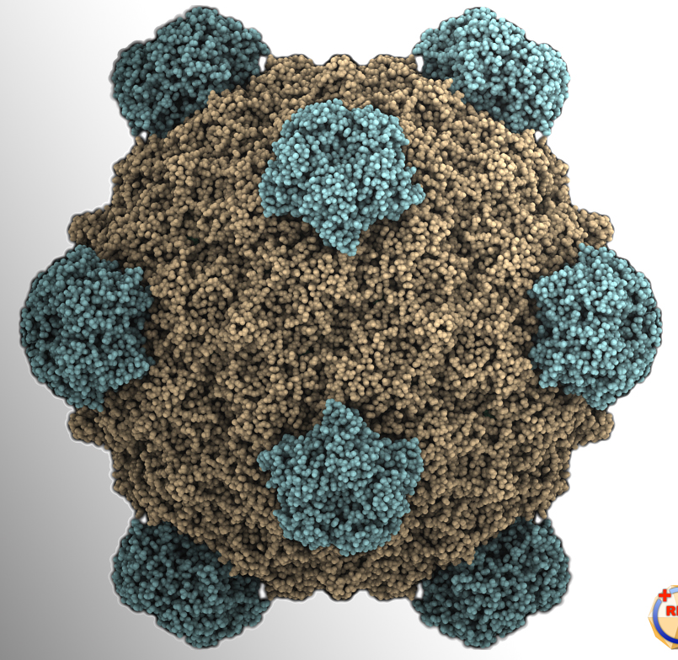
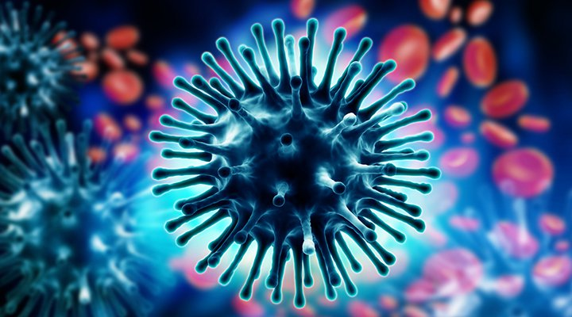
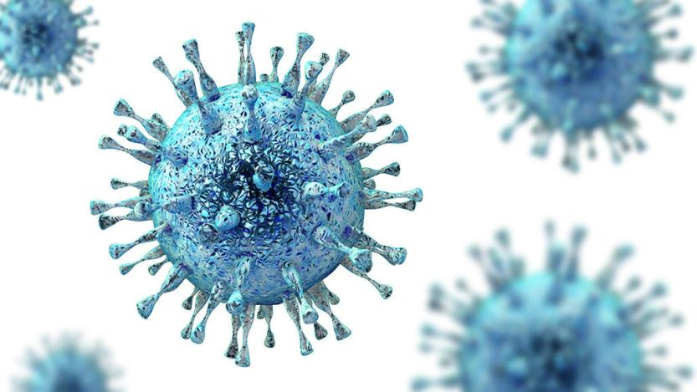
My background
W&L class of 2010, PhD in ecology and evolution from FSU, postdoc at ASU
My research focuses on the genetics of viral adaptation
Experimental evolution of bacteriophages
Drug resistance in influenza
Population dynamics of congenital cytomegalovirus infection

Slide 3
Course goals
Principles of good experimental design and sampling methods
Tools and methods for describing and interpreting data
Understanding of probability
Ability to interpret results and critically assess claims from the scientific literature
Use of statistical software for data analysis

Slide 4
Course goals
Principles of good experimental design and sampling methods
Tools and methods for describing and interpreting data
Understanding of probability
Ability to interpret results and critically assess claims from the scientific literature
Use of statistical software for data analysis

Slide 5
Course Basics
Meeting times: TR 8-9:30
Office Hours: MW, 10-11 in Parmly 303
Schedule: Subject to change
Textbook: The Analysis of Biological Data by Whitlock and Schluter
Software: R and R Studio

Slide 6
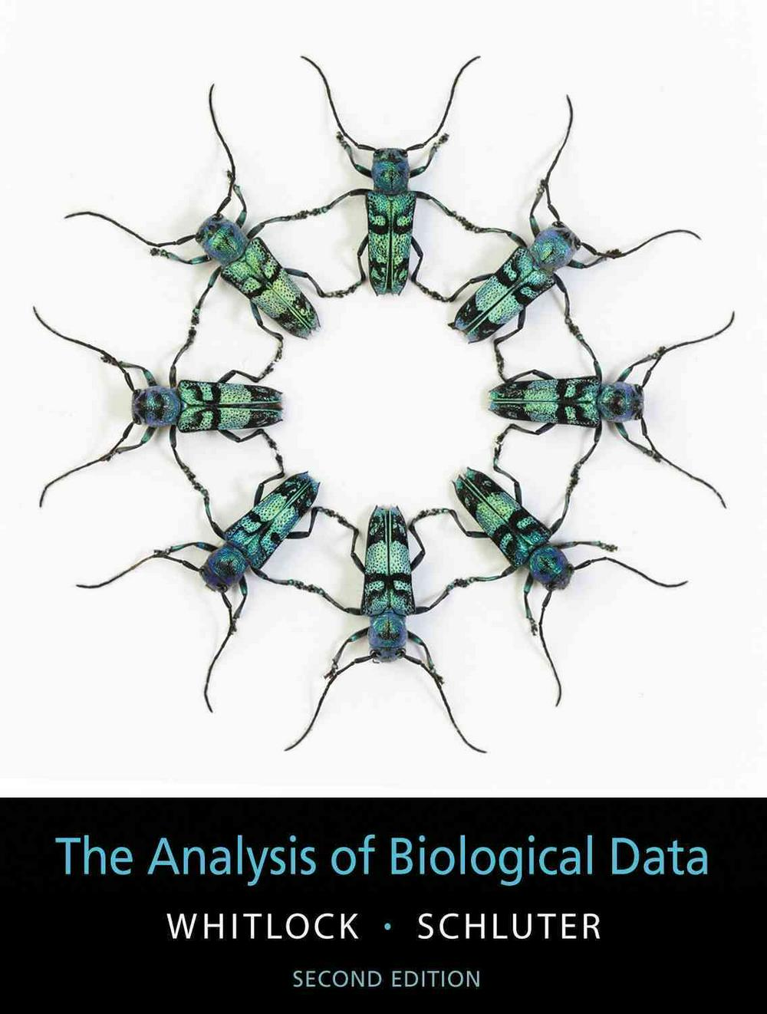
Course text
The Analysis of Biological Data by Whitlock and Schluter, 2nd edition
First edition or paperback edition are also probably fine
Provides great examples using real-world data
http://whitlockschluter.zoology.ubc.ca
Provides data and R scripts used in all examples

Slide 7
Grading
Problem sets 25 pts each
Mid-term exams 100 pts each
Final exam 200 pts
Paper summaries 30 pts
Participation 20 pts
TOTAL 700 pts

Slide 8
Open book policy
All exams will be taken at home/library/wherever, and you may use any notes, textbooks, or internet resources you would like. However, you shall not consult any other person for help beside myself.
Problem sets can be performed individually or in groups of up to three. Please turn in a single completed problem set per group, with a list of group members and a statement that each member contributed equally.
Make sure that each group member is a part of answering every question. Otherwise, you will be a disadvantage on the solo exams (which are worth far more points).

Slide 9
Course introduction
Statistics is a branch of mathematics dealing with collecting, organizing, analyzing, interpreting, and presenting data
Subfields of mathematical and applied statistics
Biostatistics is a branch of applied statistics directed toward applications in biology and the health sciences

Slide 10
Course introduction
This course is heavily focused on analyzing data
WARNING: There will be math
More important than understanding how to perform statistical tests or analyses is understanding which analyses are appropriate for a given set of data

Slide 11
pollev.com/sackman

Slide 12
R
R is a programming language and environment for statistical computing and graphics
Research and publications
We will be using it in this course for data analysis and visualization
This will not be a course in R, but we will learn enough of R to assist us in analyzing our data
If you decide that you are interested in learning more about using programming languages to analyze data, take a look at the department’s data science courses: BIOL 185 and 187

Slide 13
Why R?
Advantages:
Free and open-source
Huge array of built-in functions and extra contributed packages
Excellent graphics
Good for simulation, programming, and analyses
Large community of users
Primary disadvantage -> Potentially steep learning curve for users with no programming experience

Slide 14
RStudio
“RStudio is an integrated development environment for R.
It includes a console, syntax-highlighting editor that supports direct code execution, as well as tools for plotting, history, debugging and workspace management.”
Basically, it makes R easier for first-time users and more useful for everybody.

Slide 15
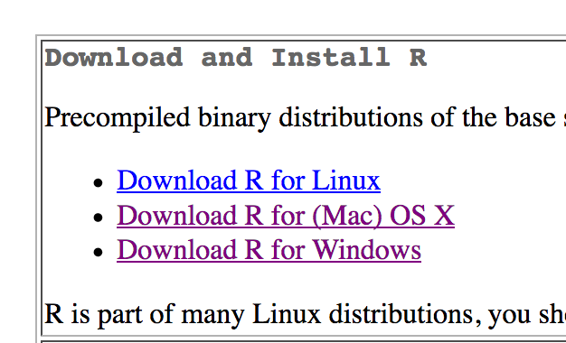
Installing R
https://cran.r-project.org/

Slide 16
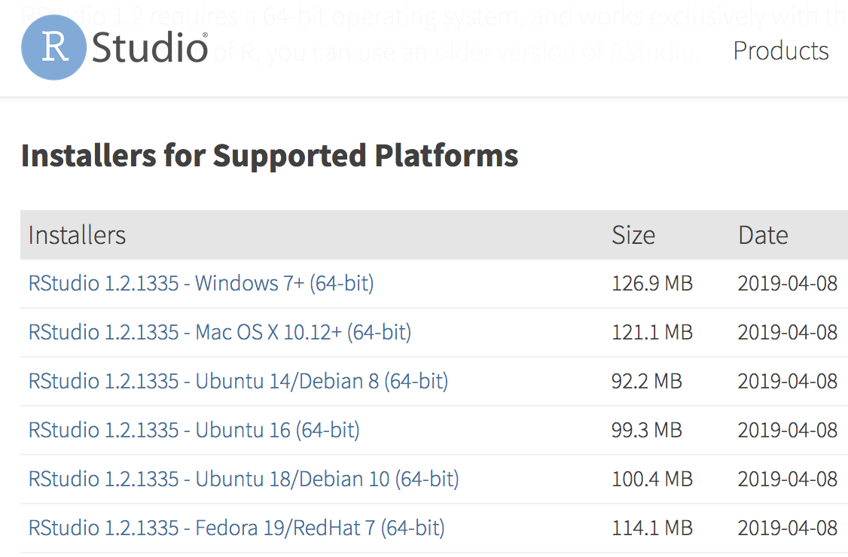
Installing RStudio
https://www.rstudio.com/products/rstudio/download/#download

Slide 17
Introductory tutorial
http://whitlockschluter.zoology.ubc.ca/r-code/intror
https://rna.wlu.edu/bio185/c-02-r-101.html

Slide 18
Please install R and Rstudio by next Tuesday and bring your laptop with you to every class

Slide 19
Let’s take a look at R and RStudio…

Slide 20
Chapter 1: Statistics and Samples
BIOL201 FALL 2019
Andrew M. Sackman, Ph.D.

Slide 21
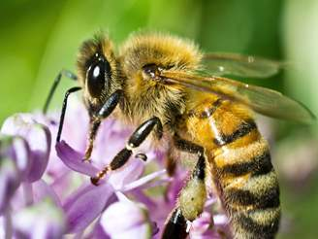
Statistics is about estimation, or inferring an unknown quantity of a population using data from a sample.
We might want to estimate, for example, the proportion of patients who experience a heart attack while taking a particular drug, or the average number of flower species visited by a species of honeybee.

Slide 22
How do we define a population?
A population is the entire collection of individual units that a researcher is interested in
This could be a potentially small group
All live oak trees in a small park
W&L students from Alabama
Or it could be so large that we couldn’t possibly measure them all
All residents of the United States who have ever consumed alcohol
The population of Atlantic salmon
Units need not be individual organisms.
Families or pairs of siblings; sections of a course

Slide 23
Measuring parameters for an entire population may be impossible, but statistics gives us the tools to estimate from a sample. This estimate is called a statistic.
Another important facet of statistics is our ability to quantify the uncertainty of an estimate

Slide 24
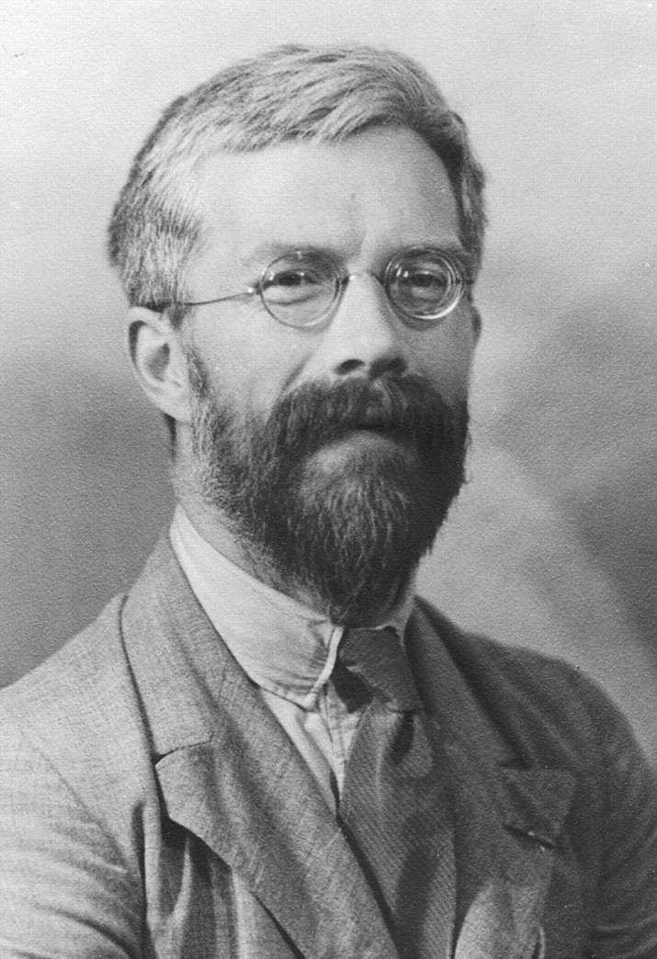
Because we seek to estimate population parameters – and even more importantly, test hypotheses – from samples, it is important that we sample properly
“To consult the statistician after an experiment is finished is often merely to ask him to conduct a post mortem examination. He can perhaps say what the experiment died of.”
-Ronald A. Fisher

Slide 25
Example of poor sampling
Study on injury rates of cats that plummet from buildings in NYC, measured from cats brought to a veterinary hospital for repair

Slide 26
What makes a good sample?
Sampling error
An ideal sample is unbiased and features low sampling error
Bias is a systematic discrepancy between our estimate and our parameter
In other words, and ideal sample is accurate and precise
To avoid bias, samples should be randomly chosen
i.e., each unit of the population should have an equal and independent chance of being chosen for the sample
Sample bias

Slide 27
So what type of error did the cat study suffer from?

Slide 28
Random sampling
The statistical methods we will learn here generally assume that sampling is random
Each unit has equal chance of being included
Each unit must be selected independently
In practice, this can range from very easy to nearly impossible
Truly random sampling eliminates systematic bias and allows us to estimate the amount of sampling error

Slide 29
Random sampling
Suppose we want to measure the presidential primary preferences of registered Democrats in Rockbridge county. How might we go about finding a sample?
BAD: Go door-to-door in randomly chosen neighborhoods
Better: Randomly call phone numbers from the voter registration database
Best: Assign each registered voter a number, and choose a subset of voters with a random number generator – still has problems due to volunteer bias

Slide 30
Volunteer bias
Human studies are highly prone to volunteer bias
Studies where participants are paid will generally have a higher percentage of low-income individuals. Conversely, unpaid studies will attract high-income individuals or retirees with plenty of free time.

Slide 31
Random sampling
In general, it is best to select individuals for samples using random number generators to ensure random and independent draws
Researchers should be careful to avoid using samples of convenience

Slide 32
Rules of random sampling
Create a list of every unit in the population, and give it a number between one and the total population size
Decide on the number of units to be sampled (n)
Use a random number generator to generate n random integers between one and the total number of units in the population
Sample the unites whose numbers are called by the random number generator

Slide 33
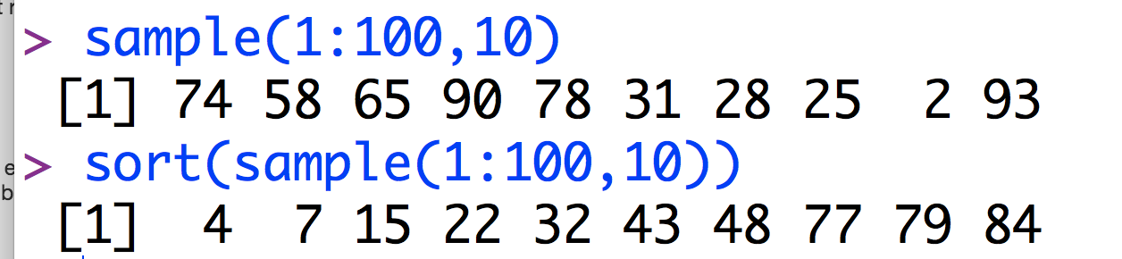
R Tip

Slide 34
Sampling need not be done on the level of single individuals

Slide 35
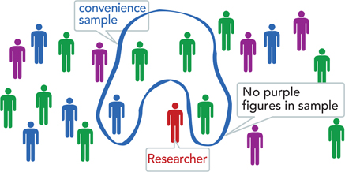
Oftentimes in science, samples of convenience are unavoidable

Slide 36
Oftentimes in science, samples of convenience are unavoidable
Shuman genetic variation using publicly available data of human genome sequences, our sample would be highly biased toward European and North American individuals, and poor in samples from Latin America and Africa (though this is changing)
If you are performing an undergraduate research study on red-backed salamanders with Dr. Marsh, you might only study individuals along a stretch of the Blue Ridge Pkwy near campus, because you are limited in resources and can’t study the enormous range of the species across the entire Eastern United States

Slide 37
Discussion
Which of these could be considered random samples?
A researcher interested in student sleep habits performs a study with the first twenty volunteers who respond to an ad posted outside the science center restrooms
A scientist samples each longleaf pine tree in transects of a region on campus that are selected by a computer program
A researcher measures the height of each student on campus whose last name starts with A, R, and V.
A researcher sets cage traps along each mile of the Blue Ridge Parkway, and measures behavioral characteristics of the first twenty chipmunks caught by each trap.

Slide 38
Discussion
Which of these could be considered random samples?
A researcher interested in student sleep habits performs a study with the first twenty volunteers who respond to an ad posted outside the science center restrooms
A scientist samples each longleaf pine tree in transects of a region on campus that are selected by a computer program
A researcher measures the height of each student on campus whose last name starts with A, R, and V.
A researcher sets cage traps along each mile of the Blue Ridge Parkway, and measures behavioral characteristics of the first twenty chipmunks caught by each trap.

Slide 39
Discussion
Give an example of how you might obtain a good sample for the following populations:
The frequency of a particular allele in the population of white-tailed deer in Virginia
The percentage of graduating seniors at W&L who play the violin
The number of different species of bacteria present per liter of water in Woods Creek

Slide 40
Types of data and variables
A variable is any characteristic or measurement that differs between individuals in a population
Data are measurements of a variable made on a sample of individuals

Slide 41
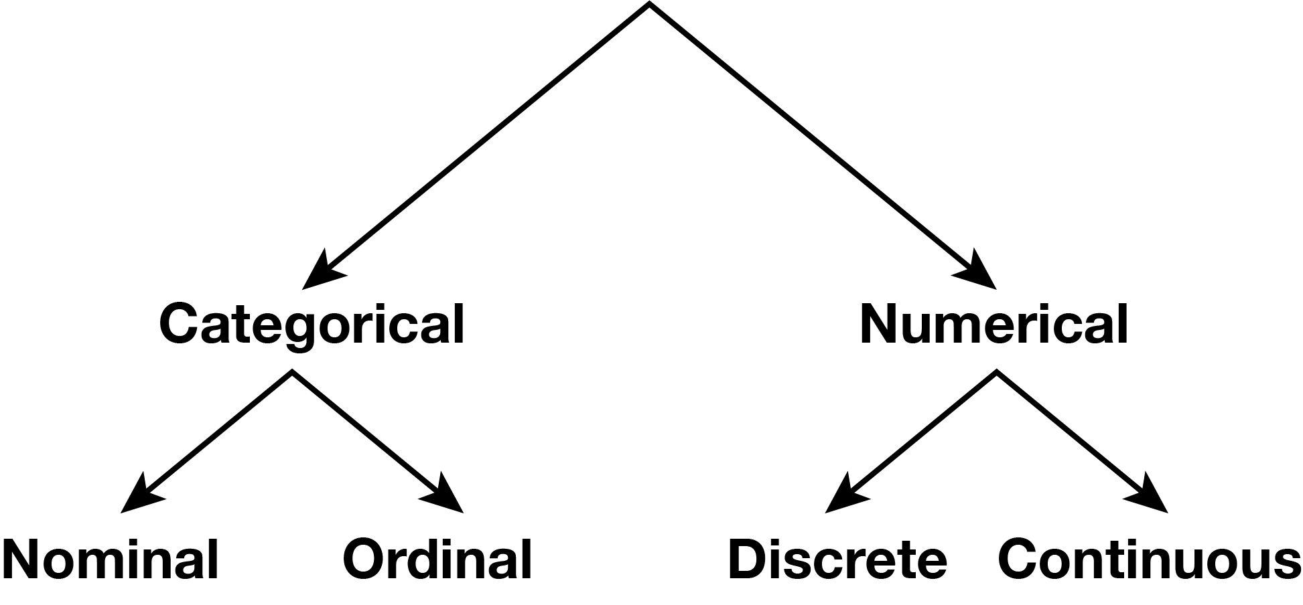
Types of data
Data come in two flavors:
Categorical
Numerical

Slide 42
Types of data
Categorical data are qualitative characteristics of individuals that have no quantifiable value on a numerical scale.
Nominal (unordered)data might be:
Color - red, blue, or green
Sex genotype – XX, XY, X0, etc.
Survival - Alive vs. dead
Ordinal (ordered) data might include:
Size category – small, medium, large
Schooling category – Elementary, middle, high school

Slide 43
Types of data
Variables are numerical when measurements are quantitative and have magnitude. These can either be continuous (any real number value within a given range, potentially rounded) or discrete (indivisible units).
Discrete data might be:
Number of cigarettes smoked in a day – 6, 7, 8, …
Number of heart attacks – 0, 1, 2, …
Continuous data might be:
Weight in kg
Duration of sleep
Time to complete a 40m dash

Slide 44
Types of variables
Explanatory variable – Manipulated in an experiment
Response variable – Change is measured to understand its relation to the explanatory variable

Slide 45
Exercise
For each of the following settings (i) identify the variable(s) in the study, (ii) for each variable tell the type of variable (e.g., categorical and ordinal, discrete, etc)
A paleontologist measured the width (in mm) of the last upper molar in 36 specimens of the extinct mammal Acropithecus rigidus.
The birthweight, date of birth, and the mother’s race were recorded for each of 65 babies.
A physician measured the height and weight of each of 37 children.
During a blood drive, a blood bank offered to check the cholesterol of anyone who donated blood. A total of 129 persons donated blood. For each of them, the blood type and cholesterol levels were recorded.

Slide 46
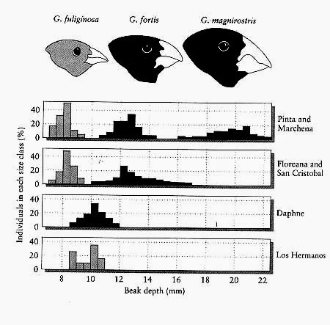
Frequency and probability distributions
Individuals in a population are variable (if there is no variation in a trait, we typically aren’t interested in it)
We can visualize variation in a sample with the frequency distribution, or the number of times each value of a variable occurs in a sample

Slide 47
Frequency and probability distributions
The probability distribution is the distribution of a variable in the whole population – This is almost impossible to know, so we usually approximate it

Slide 48
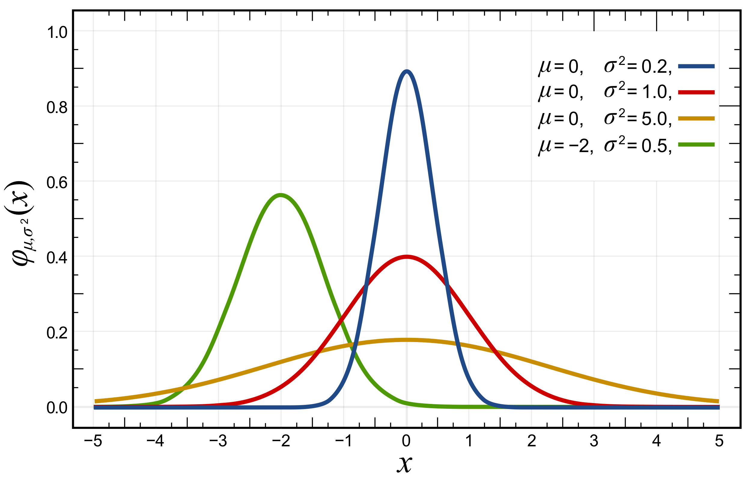
Frequency and probability distributions
The probability distribution is the distribution of a variable in the whole population – This is almost impossible to know, so we usually approximate it
Continuous variables are often modeled with a theoretical probability distribution called the normal distribution

Slide 49
Exercise
Suppose that we take a sample of size 16 from children in a primary school and get the following data about the number of their decayed teeth,
3,5,2,4,0,1,3,5,2,3,2,3,3,2,4,1
To construct a frequency table by:
Order the values from the smallest to the largest.
Count how many numbers are the same.
Relative Frequency | Frequency | No. of decayed teeth
1 | 16 | Total

Slide 50
Exercise
Suppose that we take a sample of size 16 from children in a primary school and get the following data about the number of their decayed teeth,
3,5,2,4,0,1,3,5,2,3,2,3,3,2,4,1
To construct a frequency table by:
Order the values from the smallest to the largest.
Count how many numbers are the same.
Relative Frequency | Frequency | No. of decayed teeth
0.0625 0.125 0.25 0.3125 0.125 0.125 | 1 2 4 5 2 2 | 0 1 2 3 4 5
1 | 16 | Total

Slide 51
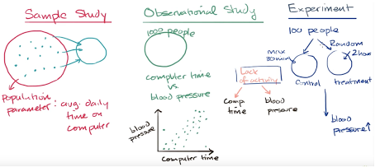
Types of studies
Studies can be classified as either observational or experimental
These are sometimes hard to differentiate

Slide 52
Observational studies can only identify associations, while experimental studies can identify cause-and-effect relationships between variables.
However, experimental studies may be impossible for ethical reasons or practical reasons.
Is cocaine use during pregnancy harmful?

Slide 53
Exercises
What feature of our estimate of a variable is affected by whether or not each individual in the population is equally likely to be chosen for the sample?
A. Accuracy
B. Precision

Slide 54
Exercises
Suppose that we ask for unpaid volunteers within a school district to complete a two-hour long in-person survey on their children’s nutritional habits. We end up with a sample with a significantly higher average household income than the school district as a whole, significantly skewing our results.
What probably went wrong with our sampling?
What could we do differently to fix the study?

Slide 55
Exercises
For each of the following studies, state which are the response and explanatory variables, and whether the studies are observational or experimental:
Forestry rangers wanted to compare the growth rates of trees growing at high altitude to those of trees growing at low altitudes. They measured growth rates using the space between tree rings in a set of trees harvested from a national forest at two different elevations.

Slide 56
Exercises
For each of the following studies, state which are the response and explanatory variables, and whether the studies are observational or experimental:
Researchers randomly assign diabetes patients to two groups. In the first group, the patients receive a new drug tasploglutide, whereas patients in the other group receive standard treatment without the new drug. The researchers compared the rate of insulin release in the two groups.

Slide 57
Exercises
For each of the following studies, state which are the response and explanatory variables, and whether the studies are observational or experimental:
Psychologists tested whether the frequency of illegal drug use differs between people suffering from schizophrenia and those not having the disease. They measured drug use in a group of schizophrenia patients and compared it with that in a similar sized group of randomly chosen people.

Slide 58
Exercises
For each of the following studies, state which are the response and explanatory variables, and whether the studies are observational or experimental:
A group studied a species of spider whose females often eat males that try to mate with them. The researchers removed a leg from each male spider in one group ( to make them weaker and more vulnerable to being eaten) and left the males in another group undamaged. They studied whether survival of males in the two groups differed during courtship.

Slide 59
Next class
Chapter 2 – Displaying Data
Please bring your laptops!!

Slide 60
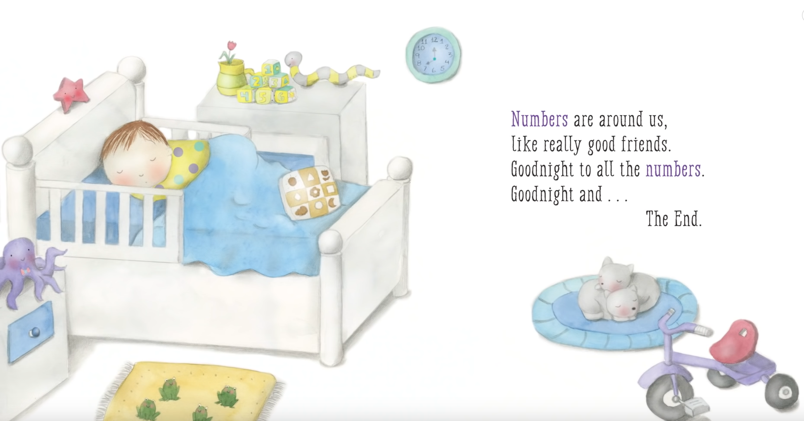
s

